Slide 1

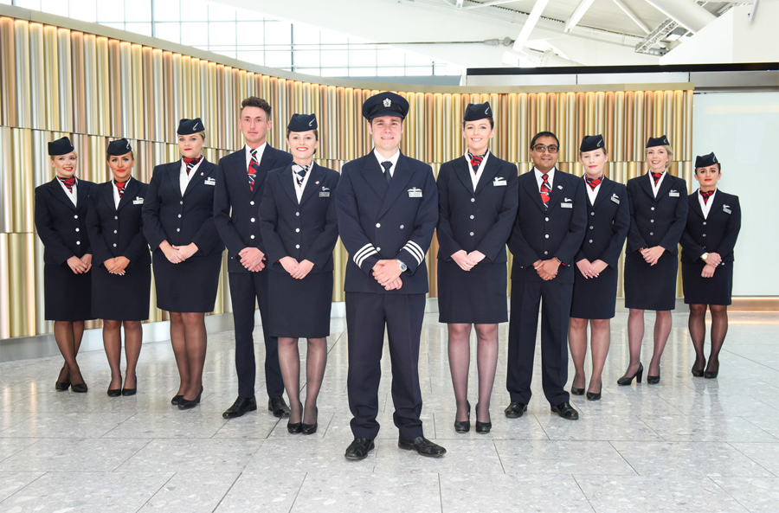
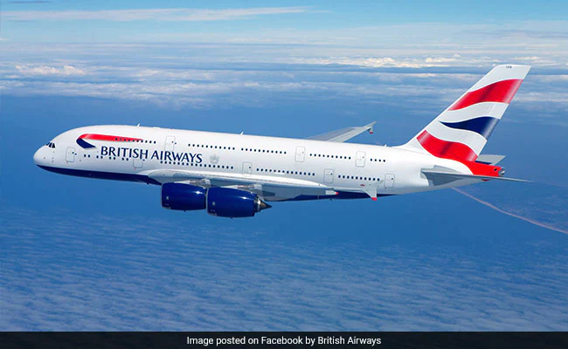
Predictive modeling of customer bookings: British Airways
Task 2 Presentation
By
EMMANUEL Nenchin

Slide 2
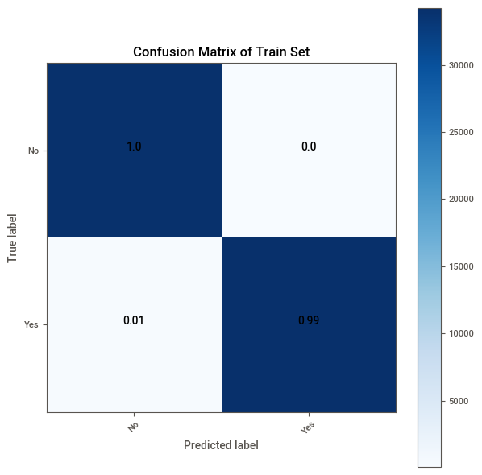
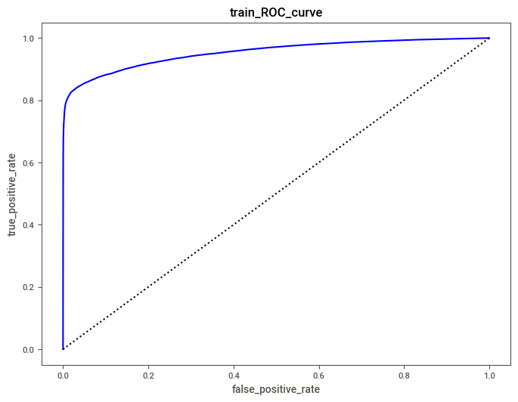
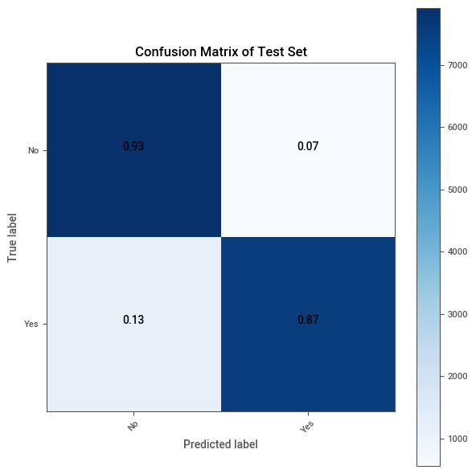
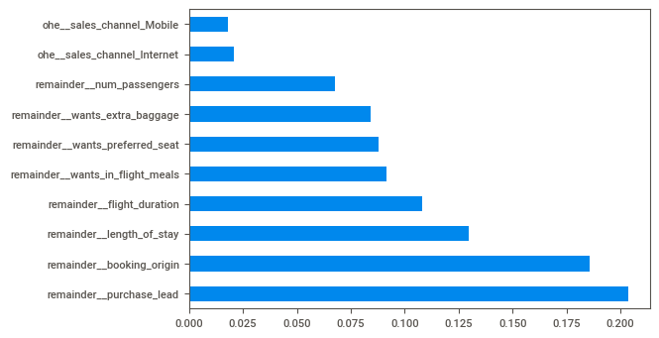
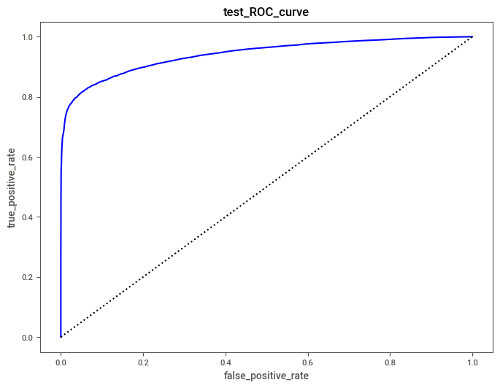
Results
Random Forest (criterion='entropy') Algorithm was used.
The model when evaluated with the training set gave a precision, recall, f1, and an ROC score of 99.81%, 99.39%, 99.60%, and 95.36% respectively.
For the test set the move gave precision, recall, f1, and an ROC score of 93.11%, 86.62%, 89.75%, and 94.15% respectively.
Feature Importance of the Top 10 Features

